Slide 1
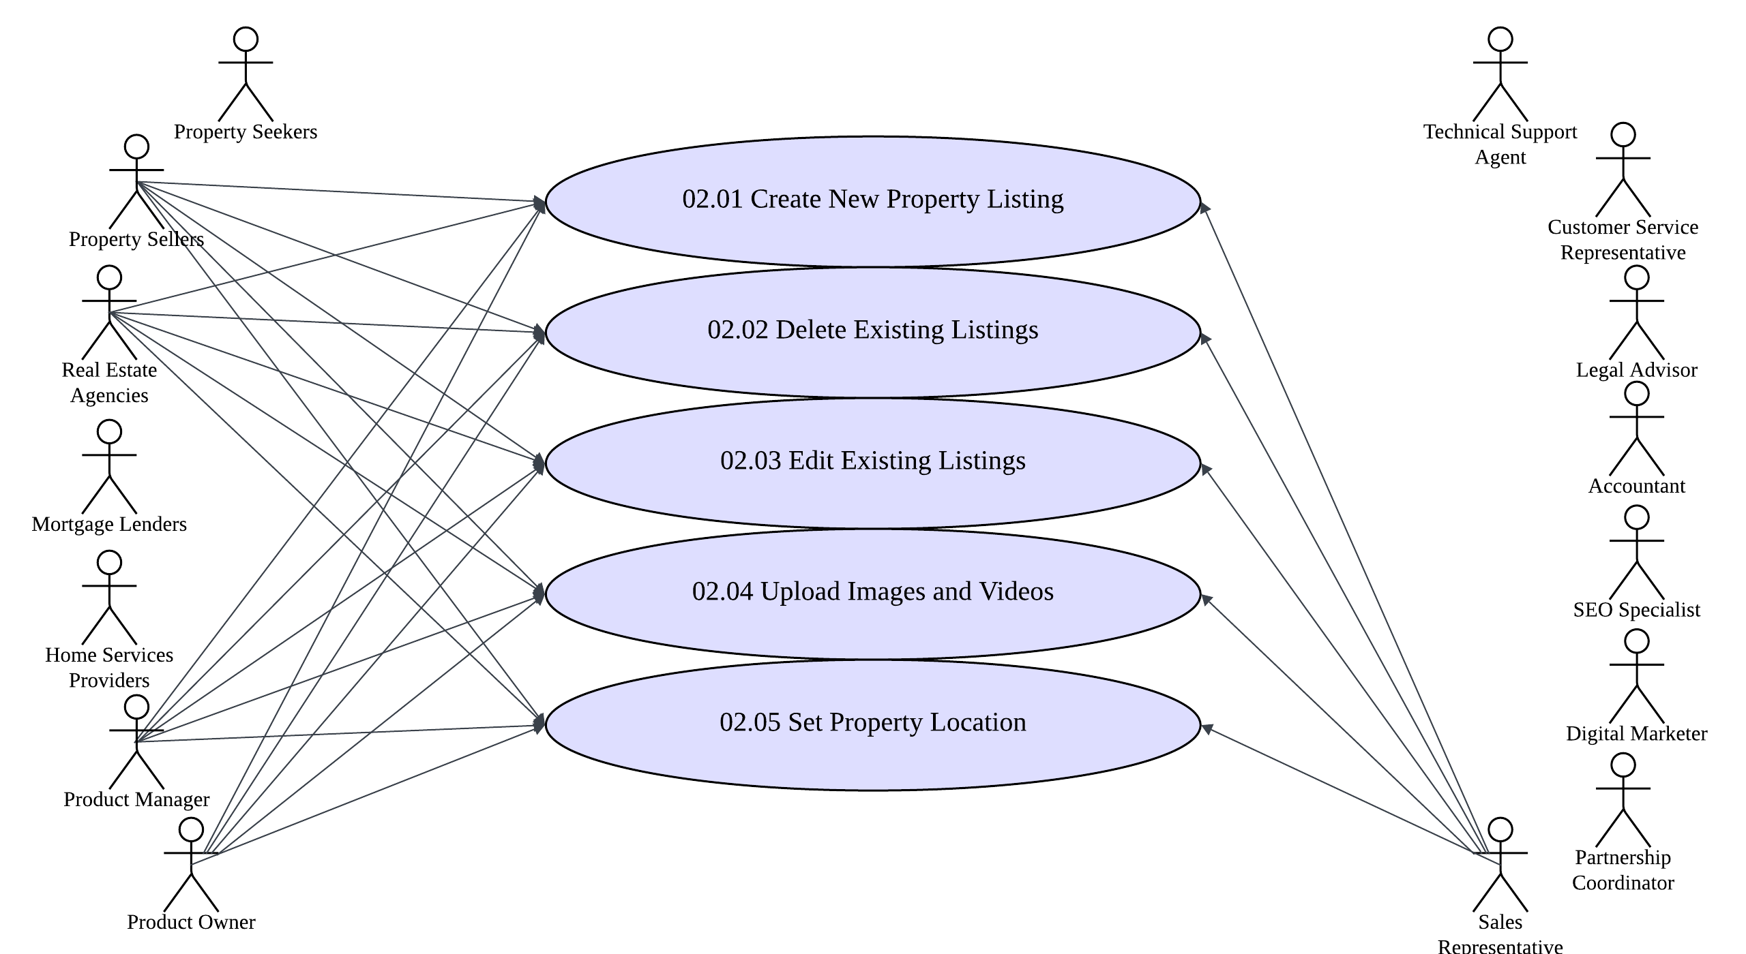
Use Case Diagram
House Hunt Web Application
Use Case Diagram
Module: 02. Property Listings
Color code: Implementation scope – this semester

Slide 2
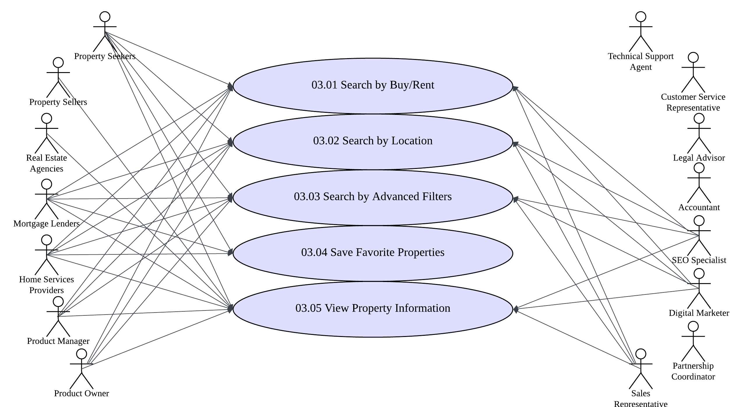
Use Case Diagram
House Hunt Web Application
Use Case Diagram
Module: 03. Property Search

